Slide 1
Cloud Jenkin Platform - Admin Training

Slide 2
TOC
Introduction to CI & CD
Introduction to CloudBees Jenkins Platform (CJP)
CloudBees Enterprise Jenkins (CJE)
Command-Line Interface
Distributed Builds
CloudBees Jenkins Operations Center (CJOC)
Client Masters
Shared Slaves
Security
Access Control with RBAC Plugin
High Availability (HA)
Backup Scheduling
Monitoring
Nodes Plus
Fast Archiver
Pull-Request Builder for GitHub
Custom Update Center
NIO SSH Slaves
Even Scheduler
CloudBees Jenkins Analytics
Cluster Operations
CloudBees Support

Slide 3
Introducing Jenkins

Slide 4



Introducing Jenkins

Slide 5
Introducing Jenkins
ever growing popularity: 100k installations!
used in every sector
software (Yahoo, Google, JBoss/RedHat, HP, Microsoft, …)
telecom (Nokia, Alcatel Lucent, Ericsson, …)
banking
manufacturing
public sector
...

Slide 6




Introducing Jenkins
What makes Jenkins so great?
distributed
builds
reporting
ease of use
extreme
extensibility

Slide 7
Where do we start?
Installing Jenkins
Configuring Jenkins

Slide 8
Installing Jenkins

Slide 9
Installing Jenkins
Download jenkins.war from the website
Run as a stand-alone application
Run in a servlet container
Install system packages (recommended)

Slide 10
Running Jenkins as a stand-alone app
Run from the command line
Uses an embedded application server
Some extra features (restart from the web interface,...)
$ java -jar jenkins.war --httpPort=8081

Slide 11
Running Jenkins as a stand-alone app
Other useful options
--prefix: control context path for reverse proxy
--httpListenAddress: limit interfaces
--logfile: write to a file instead of stdout
--httpsCertificate / --httpsPrivateKey
Signal
Upon SIGALM, log file gets reopened

Slide 12



Running Jenkins on application server
Deploy Jenkins to an existing application server
May fit in better with existing infrastructure
Just deploy the jenkins.war file in the usual manner
jenkins.war

Slide 13
Installing Jenkins on Linux
Native packages are available for the major Linux distributions
Check out the Jenkins web site for detailed instructions
Example for Redhat:
$ sudo wget -O /etc/yum.repos.d/cje.repo \
http://nectar-downloads.cloudbees.com/cje/1.609/rpm/jenkins.repo
$ sudo rpm --import \
http://nectar-downloads.cloudbees.com/cje/1.609/rpm/jenkins-ci.org.key
$ sudo yum install jenkins
$ sudo service jenkins start

Slide 14
More on Linux native packages
Based on stand-alone jenkins.war
Uses an embedded application server
Benefits
Create jenkins users, set up /etc/init.d
Configuration files follow native conventions
Log rotation
Where are files
Settings in /etc/default/jenkins or /etc/sysconfig/jenkins
JENKINS_HOME defaults to /var/lib/jenkins

Slide 15
Installing Jenkins on Windows
Run either:
setup.exe
jenkins.msi if .NET 2.0 runtime is already available
Install Jenkins as a Windows service
All the files go into $JENKINS_HOME
Config file is in $JENKINS_HOME/jenkins.xml
Beware! It gets overwritten

Slide 16
Other installers
MacOSX
pkg file that sets up Jenkins for auto-start upon boot

Slide 17
Runtime requirements
Supported JDKs
OpenJDK 8 or Oracle JDK8
Oracle JDK 7
Basic JVM Memory Sizing
Heap size: -Xms2G -Xmx2G
PermGen on JDK7: -XX:MaxPermSize=256m
G1 garbage collector for heap > 4Gb : -XX:+UseG1GC
System Limits on Linux / Unix
open files
max processes

Slide 18
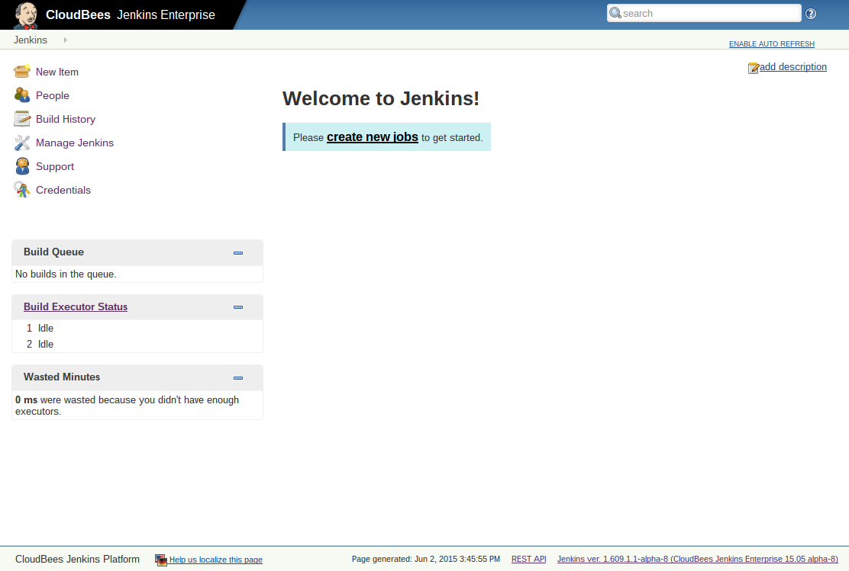
Welcome to Jenkins!

Slide 19
Configuring Jenkins

Slide 20
Jenkins Home Directory
This is where all the important data goes
Need to be backed up, etc.
Can be set in several ways
JENKINS_HOME system property
JENKINS_HOME environment variable
Falls back to ~/.jenkins
Can be verified from system config page

Slide 21
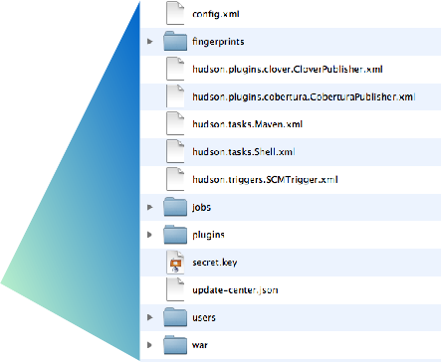
Jenkins Home Directory structure
General configuration file
Build job workspaces, history and artifacts
Installed plugins
JENKINS_HOME
Local user database

Slide 22
Jenkins Home Directory
Prepare for disk usage growth
Especially when you start to host jobs from people who aren’t close to you
Make sure you can throw more disks at the problem later
No need to waste money on 15000rpm SCSI disks
But bigger disk is nice
Can be network mounted (NFS / SAN / CIFS)

Slide 23
Expandable volume
“Spanned volume” on Windows
LVM on Linux
This needs the most upfront planning
ZFS
Shame there’s no viable free Solaris flavor
$JENKINS_HOME should be its own FS
If it’s too late, symlink is your friend

Slide 24
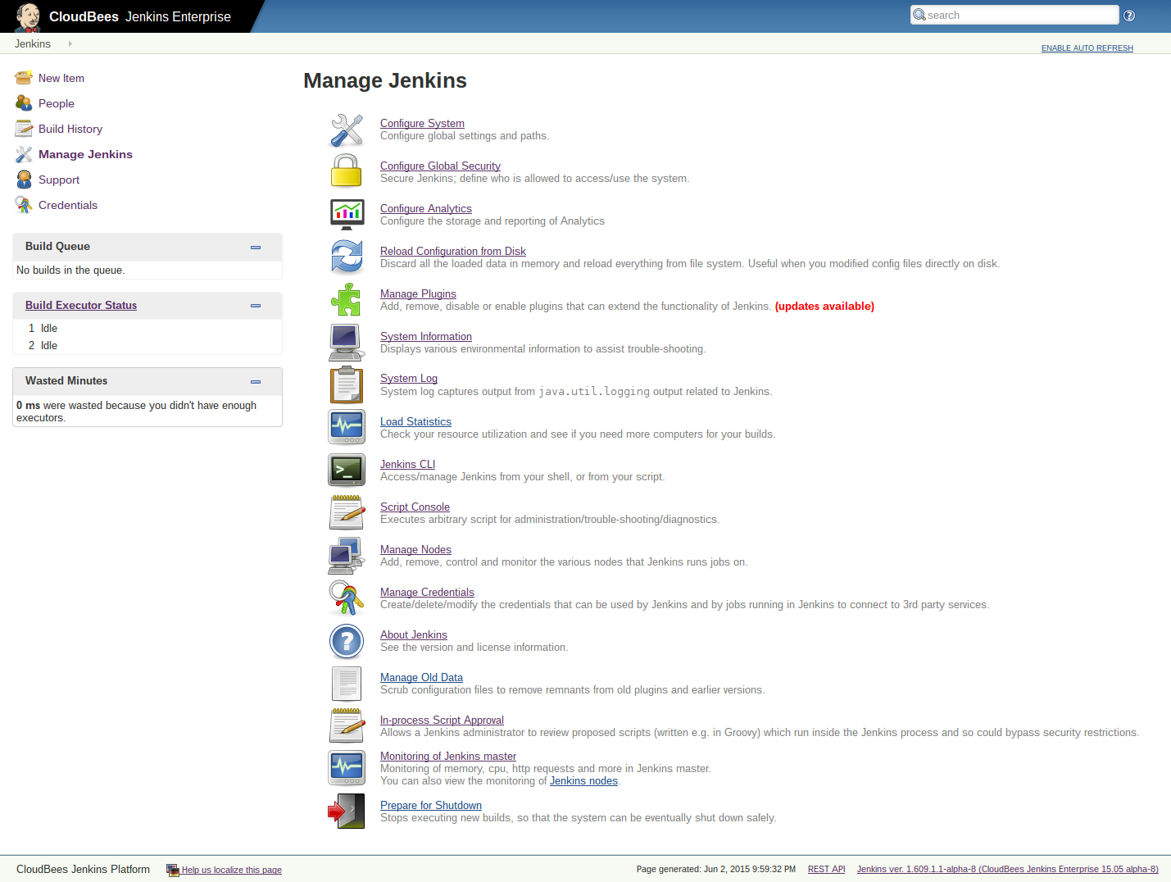
Manage Jenkins

Slide 25
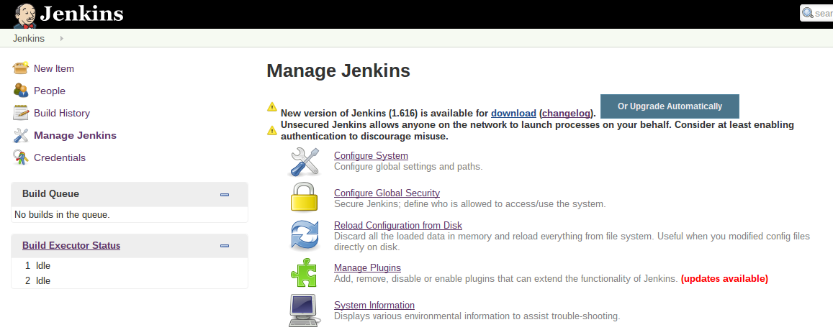
Upgrade of Jenkins
You’ll receive notification when new version is released
Download the latest version and install manually
Or upgrade automatically

Slide 26

System configuration
You can configure many aspects of your Jenkins server:
Security
JDK installations
Build tools - Ant and Maven installations
Version control tools
Email configuration
Plugin-specific configuration

Slide 27
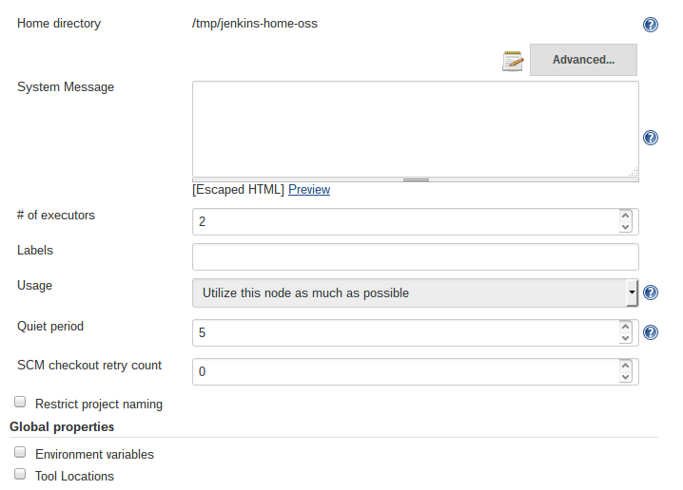
System Configuration: General
Some miscellaneous system parameters

Slide 28
System Configuration: Message
Type arbitrary HTML to show in top page
Often used to describe installation
Pointer to Wiki page, who to contact, etc.
Putting JavaScript is not supported anymore for security reasons

Slide 29
System Configuration: # of Executors
What is ‘Executor’
Unit of task execution on a computer
Defines upper bound of concurrent build execution
Typically, you set this to # of CPU cores
Unless your builds are highly parallel in itself
Watch out for memory requirement

Slide 30
System Configuration: Quiet period
Waits for this many seconds before actually build
Groups related commits together
Originally introduced for CVS
to collapse multiple CVS change notification into one
Still somewhat useful for other SCMs

Slide 31
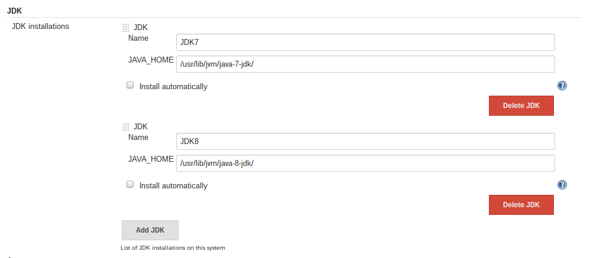
System Configuration: JDKs
Define the JDKs you need for your projects
You can define multiple versions for different projects

Slide 32
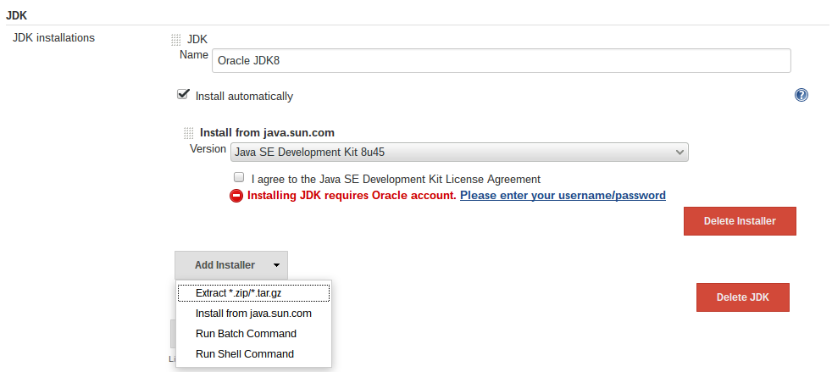
System Configuration: JDKs
Install JDKs automatically
Download from Oracle web site
Or use locally available archive

Slide 33
System Configuration: Build tools
Define the build tools you need to build your projects
By default, Jenkins can use shell, Ant and Maven
You can add many more with plugins
Groovy, Gradle, Grails, sbt, NodeJS …
Many support multiple versions of the tool
Some support auto-installation

Slide 34
System Configuration: SCM tools
Subversion and Git are supported out-of-the-box
Plug-in support for others:
CVS, Mercurial, Perforce, Team Foundation Server, …
Most requires the tools to be separately installed

Slide 35
SCM and authentication
Most SCM tools support/require authentication when talking to servers
How to configure Jenkins depends on SCM
Some can use Credentials plugin (Git, SVN)
CVS
All authentication needs to be done on CLI before use
Make sure to do this from the same user
Perforce
Each project needs you to enter credential separately

Slide 36
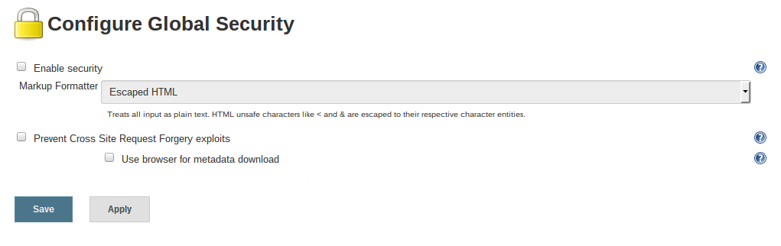
Global Security
Unsecured Jenkins allows anyone on the network to launch processes with Jenkins rights
Consider at least enabling authentication to discourage misuse.
Check to enable

Slide 37
Invest in good URL
If your users can’t see Jenkins, much of the benefit is lost
Make the URL easier to remember
Bad: http://tjek-02.int.rev.example.org
Good: http://jenkins.example.org

Slide 38
Use name service
Get the host alias, instead of using primary machine name
If your IT isn’t helping, use dynamic DNS
This also makes your service relocatable

Slide 39
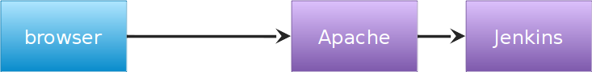
No “/jenkins”
Use virtual host to distinguish multiple apps, not context path
http://jenkins.example.org
http://jira.example.org

Slide 40
Command-Line Interface

Slide 41
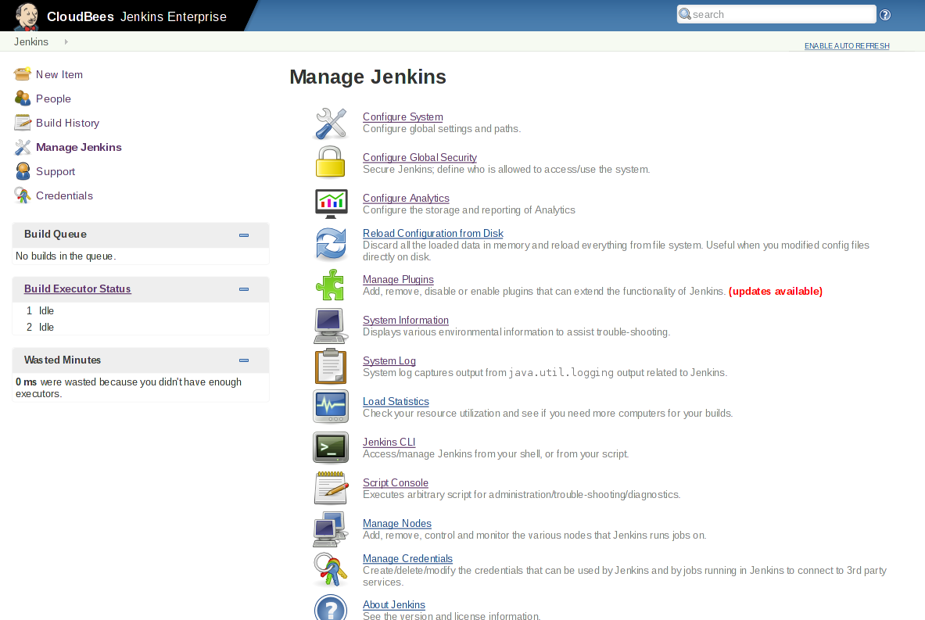
Using CLI
Entrance to CLI (or /cli)

Slide 42
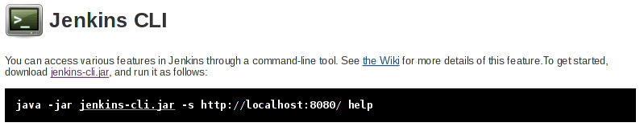
Using CLI
“-s” sets Jenkins to connect to
“JENKINS_URL” environment variable replaces it if needed

Slide 43
How it works
CLI makes an HTTP call to Jenkins, discovers the port
CLI attempts to open TCP/IP connection
If it fails, fall back to HTTP-based connection
Slow and wastes effort, but works with reverse proxy
Command execution mostly happens on master
But sometimes code gets downloaded
Therefore, one CLI jar can be used to talk to different masters
CLI JVM
Jenkins

Slide 44



CLI Authentication
By SSH public key
Register your public key to Jenkins under your user account
Hide your private key in ~/.ssh
Jenkins JVM
CLI JVM
User | Public Key
Kohsuke
Ryan
Stephen

Slide 45
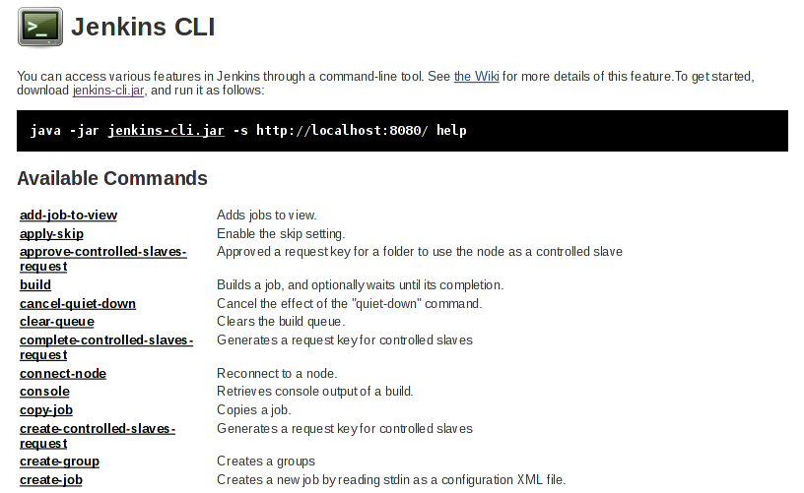
Existing CLI commands
Plugins can contribute commands, this list can grow

Slide 46
CLI Show Case: build command
Equivalent of clicking “build now”
Can take parameters:
-c:run polling first and build only if there’s a change
-s: don’t just schedule, but wait until the build is completed
-p: specify build parameters
-v: report console output as well

Slide 47
CLI Show Case: CRUD of jobs
create-job, get-job, update-job, delete-job
Reads/writes XML representation of the job
use stdin/stdout of CLI process
Can be used to script job creation / update

Slide 48
CLI Show Case: groovysh
Interactive Groovy shell to manipulate the in-memory state of Jenkins
Equivalent to the script console, but interactive
% java -jar jenkins-cli.jar -s http://localhost:8080/ groovysh
Groovy Shell (1.6.0, JVM: 1.6.0_26)
Type 'help' or '\h' for help.
-----------------------------------------------------------------
groovy:000> import jenkins.model.Jenkins
===> [import hudson.model.*, import jenkins.model.Jenkins]
groovy:000> Jenkins.instance.description
===> My description

Slide 49
More on Groovy in CLI
Use “groovy” command to run a pre-authored script file
See https://github.com/jenkinsci/jenkins-scripts for scripts other people wrote

Slide 50
Write Your Own Scripts
Useful references
http://javadoc.jenkins-ci.org
For a better assisted environment:
Set up a plugin development environment
Your IDE can now provide debugger, content assist, javadoc lookup, etc.

Slide 51
Distributed Builds

Slide 52
What are distributed builds?
Distributed builds are builds run on nodes other than the master node.
Master
Serves HTTP requests
Stores all important info
Slaves
170KB single jar
Assumed to be unreliable
Scale to at least 100
Distributed build architecture is a Jenkins best practice.

Slide 53
What are distributed builds?
Slave agent is a small Java program
Runs locally on the machine that it controls
Access files, fork processes, etc., on behalf of master
Communication with master
Needs a bi-directional byte stream
Very flexible in how this gets set up
No shared file system, no network topology constraints, etc

Slide 54
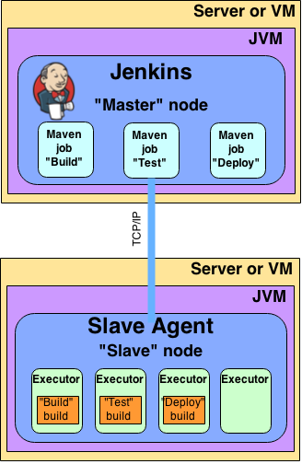
What are distributed builds?

Slide 55
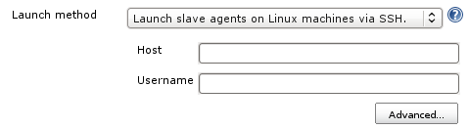
What are distributed builds?
Communication between Jenkins and Unix slaves can be via SSH
Only need SSHD on slaves
Java installed for you
Just need a host name and credentials to connect

Slide 56
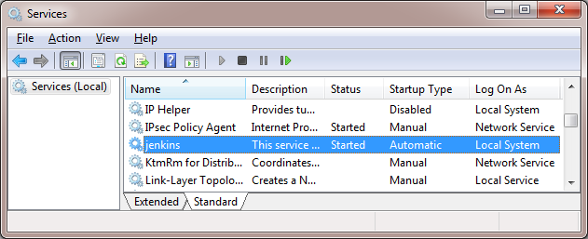
What are distributed builds?
To connect Jenkins to Windows slave, DCOM is an option
Just need admin user name and password
No manual intervention
Works even from Unix masters

Slide 57
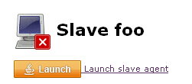
What are distributed builds?
To connect Jenkins to Windows slave or a slave in another data center, Java Web Start is another option
For cases when the master cannot “see” slaves
A separate socket connection is made
Once started, can be installed as a service
Can also be run headlessly via jar

Slide 58
Benefits: scalability
Masters can use resources to orchestrate, allowing one master to orchestrate 100s to 1,000s of builds a day.
Scaling when build demand increases will only involve pointing Jenkins at another slave node, rather than creating an entirely new master from scratch.

Slide 59
Benefits: security
Jobs that run on a master have full permissions on all Jenkins resources on the master node, potentially allowing a malicious user to access private information from other builds or the system itself.
Running jobs on separate and isolated machines mitigates this risk.

Slide 60
Where do we start?
Slaves must be able to establish bi-directional communication with a master.
Slaves also need build tools installed to them to build your jobs.
It is a best practice to configure a job to assume that the target slave doesn’t have any tools install and make tool installation part of the build process.
Once slaves have been created, jobs can be configured to only run on slaves with specific label names.

Slide 61
Setting up CloudBees Jenkins Operations Center

Slide 62
How do I set up CJOC?
CJOC requires the following:
A VM or server
At least 1 GB for the JVM
One of the following OSs:
Debian
Redhat
Ubuntu
CentOS
Fedora
OpenSuse
Windows
The CJOC WAR or Linux package
Optionally:
A second VM or server for an HA node
A load balancer
NAS accessible from both CJOC nodes

Slide 63
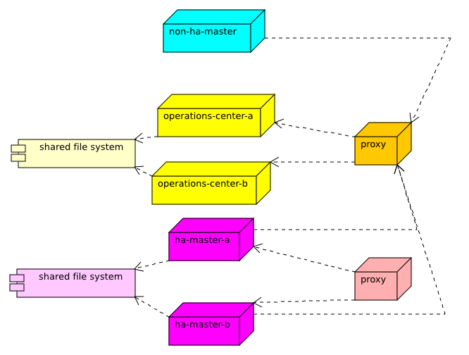
How do I set up CJOC?
General clustered CJOC architecture

Slide 64
Lab Exercise:
Setting up CloudBees Jenkins Operations Center

Slide 65
Distributed Masters and Slaves Architecture with CJOC

Slide 66
What is a distributed architecture?
In OSS Jenkins, a distributed architecture is one where masters can distribute a workload between nodes called build agents or slaves.
With CloudBees, another architecture is also possible, where slaves and even masters can be dynamically brought online to build and schedule workloads respectively.

Slide 67
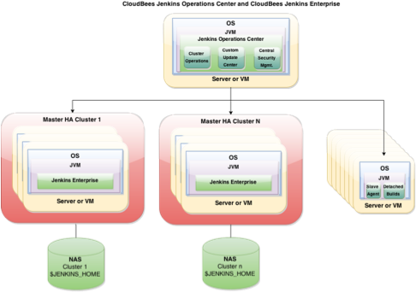
What is a distributed architecture?

Slide 68
Benefits: efficient resource usage
Jenkins masters and their slaves can be dynamically provisioned, allowing offline resources to be utilized elsewhere.
Jenkins masters will be able to orchestrate more builds.
Slaves and masters can be created from a template, standardizing them and reducing master onboarding time to 0.

Slide 69
Where do we start?
Install Operations Center, then configure client masters and shared slaves
See other sections for details on this

Slide 70
Client Masters

Slide 72
Shared Slaves

Slide 73
What are Shared Slaves?
A Jenkins build node configured to be “leased” to masters using CloudBees Jenkins Operations Center.
Slaves can be managed or unmanaged

Slide 74
What are Shared Slaves?
Shared slaves, just like typical Jenkins slaves, run build jobs using executors.
When a slave is connected to a master, all configured executors on the slave are available to that master.
Client masters can be configured to limit how many concurrent executors can be connected to them.

Slide 75
What are Shared Slaves?
Shared slaves can be connected to CJOC using the same connection methods as typical Jenkins slaves:
SSH
Java Web Start
Via a command on the master
As a Windows service

Slide 76
What are Shared Slaves?
Shared slaves can be configured to have availability policies as well:
Online as much as possible
Offline when idle
Online according to a schedule
Online when in demand

Slide 77
What are Shared Slaves?
Unlike typical slaves, shared slaves are treated by CJOC like jobs – dashboard level objects that can be configured, deleted, have role restrictions, and be placed into folders
Can be restricted to certain masters using folders
Shared slaves can be shared between masters, based on the masters’ slave policy and if any labels are configured.

Slide 78
What are Shared Slaves?
Shared slaves by default lease for one and only one job build before returning to the pool.
This is called a “one-shot” build mode.
If the slave/client master connection is interrupted, the client master will not be able to return the slave until the connection is re-established.
In this case, slave can be re-used by client master.

Slide 79
What are Shared Slaves?
Typical architecture with shared slaves

Slide 80
Benefit: scalability
Shared slaves are leased on demand to client masters, eliminating need to tie slaves to individual masters in a Jenkins installation
Shared slaves can be brought offline for maintenance with the click of a button
A cloud for shared slaves may be configured, e.g. vSphere
Allows slaves to be templatized instead of individually configured

Slide 81
Benefit: efficiency
Leasing slaves and only bringing them online when needed allows organizations to free up slave VMs/machines for other uses
No slave resource will be wasted – if one master is not using a given slave, it is free for another to use
Teams can share scarce specialty resources between masters – e.g. Windows/OSX slave machines

Slide 82
Where do we start?
The slaves you want to shared with CJOC will need to be accessible over TCP/IP
Port can be configured, random otherwise.
Port advertised in a special HTTP header.
Good practice to assume connecting slave does not have required tools installed
Include in build a step to install tools from an SCM like Subversion
Can cache tools on the master
Custom Tools Plugin – generic tool installer for jobs

Slide 83
Lab Exercise:
Creating Shared Slaves

Slide 84
Security

Slide 85
Role-based Access Control with CJOC

Slide 86
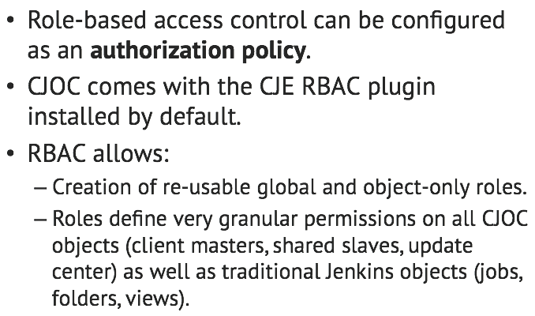
How do I use CJE RBAC with CJOC?

Slide 87
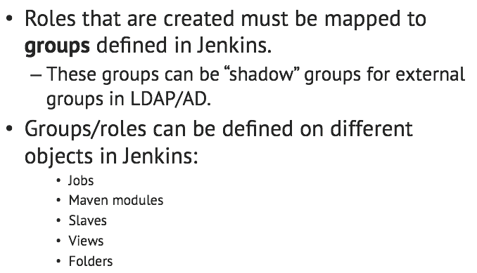
How do I use CJE RBAC with CJOC?

Slide 88
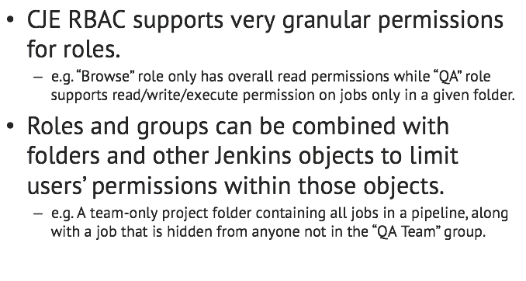
Benefits: granularity

Slide 89
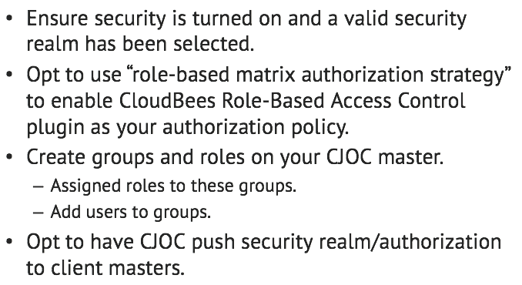
Where do we start?

Slide 90
Lab Exercise:
Setting up Role-based Access Control

Slide 91
High Availability(HA)

Slide 92
What is High Availability
Jenkins Enterprise has the capability to run in a high availability setup.
Two or more Jenkins master instances can be place in the HA singleton cluster to ensure very high uptime.
If for some reason a Jenkins master node becomes unavailable, another node in the cluster can automatically assume the master role.

Slide 93
What is High Availability(cont.)
The fail-over is very minimal, and usually takes around the same time as a normal Jenkins reboot.
Keep in mind that this is not a symmetric cluster, and other nodes will not share the load. Only one node will be active as the master, while others will be in standby.

Slide 94
Benefits: Constant uptime for Jenkins master nodes
With Jenkins HA, you maintain almost 100% uptime even through nodes becoming unavailable.
An HA setup can be combined with other plugins such as Long-running builds and Checkpoints to recover builds that were running when a node became unresponsive so data is not lost.

Slide 95
Where do we start?
Create a high availability setup using NFS as storage and IP aliasing as a reverse proxy mechanism.
NFS allows for all nodes in the cluster to have access to $JENKINS_HOME, and grants the nodes the ability to read and write to the file system simultaneously.
The reverse proxy mechanism allows fail-overs to be hidden from Jenkins end users if/when they happen.

Slide 96
Lab Exercise:
<labName>

Slide 97
Backup Scheduling

Slide 98
What is Backup Scheduling?
Backups can be performed as Jenkins jobs using the CJE Backup plugin OR CJOC’s Cluster Operations.
Backups can be run either on a schedule, a trigger, or be run manually by an administrator.
Taking regular backups is a Jenkins best practice.

Slide 99
Benefits: improved DR times
A backup allows Jenkins instance to be restored despite a misconfiguration, accidental job deletion, or data corruption.

Slide 100
Where do we start?
Set a backup policy - what configurations and records need to be saved from the master? How often should backups be taken? Where should backups be stored?
Set up a job of the type backup and give it a schedule/trigger
OR
Set up a CJOC cluster operation with a backup step and give it a schedule/trigger

Slide 101
Lab Exercise:
Creating a backup job

Slide 102
Monitoring your Jenkins

Slide 103
What is monitoring plugin doing?
It collects various metrics about how Jenkins is performing.
It provides graphs of the metrics.
It can be configured to send email alerts when metrics deviate from user defined ranges.

Slide 104
Benefits: CPU usage
Shows the CPU usage of the System as well as by the JVM on master

Slide 105
Benefits: Heap and non-heap used
The percentage of the master’s JVM’s heap and non-heap memory pool that is currently in use.
In both case, we can see memory pressure if always over 80%

Slide 106
Benefits: File descriptors in use
The percentage of file descriptors in use by the Jenkins master
When Jenkins runs out of file handles jobs can start failing at random.

Slide 107
Benefits: Web-UI requests
The rate of web requests against the Jenkins master UI
Can monitor if the architecture of your installation needs to be upgraded

Slide 108
Benefits: The build queue
Can see when the build queue grow significantly
Build queue length
Can see if you need more slaves
Average build duration
Can detect if a job is stuck on the build queue
a job is stuck if there is no executors available and has been waiting more than 10 times its estimate build duration

Slide 109
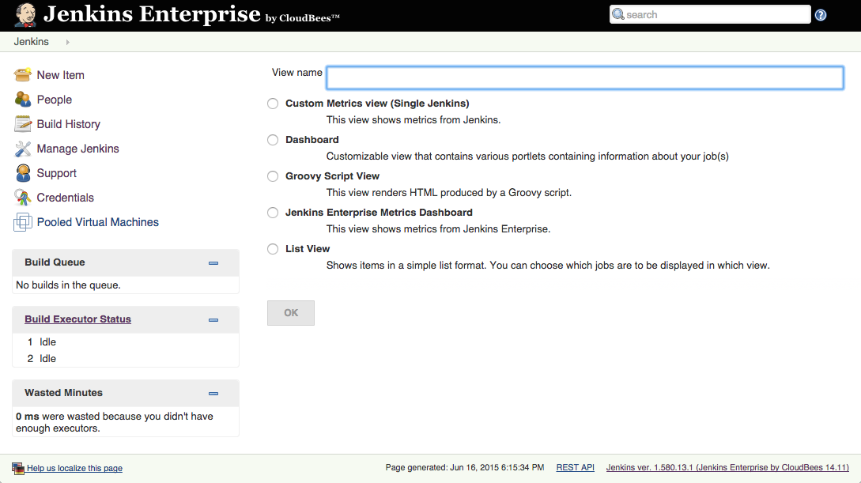
Where do we start?
Create a view at $JENKINS_URL/newView

Slide 110
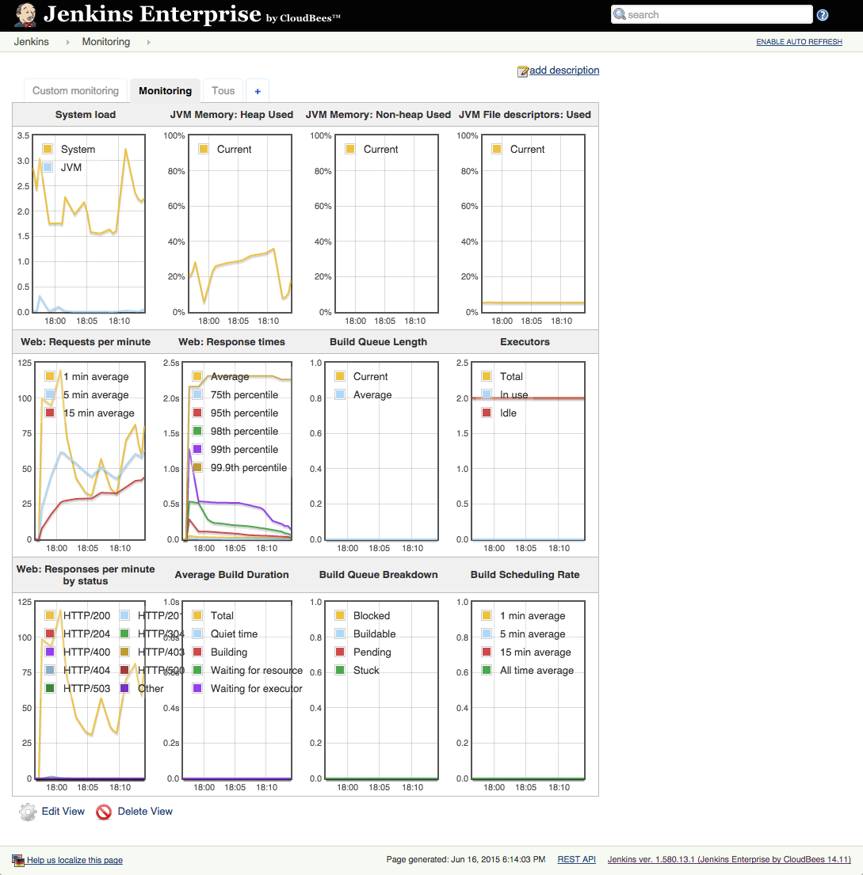
Where do we start?
Jenkins Enterprise Metrics Dashboard

Slide 111
Benefits: Jenkins Enterprise Metrics Dashboard
Simple to setup
No customization

Slide 112
Where do we start?
Custom Metrics View
Choose your design: column, overall size
Choose which metrics to display
Choose the order of the graphs
Can recreate the Jenkins Enterprise Metrics Dashboard

Slide 113
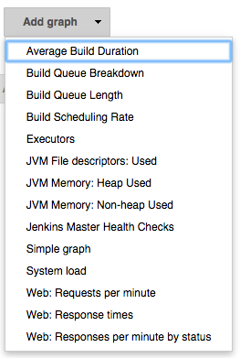
Where do we start?

Slide 114
Benefits: Alerts
Allows you to define different metrics based alerts and have Jenkins send emails when the alerts start and finish.

Slide 115
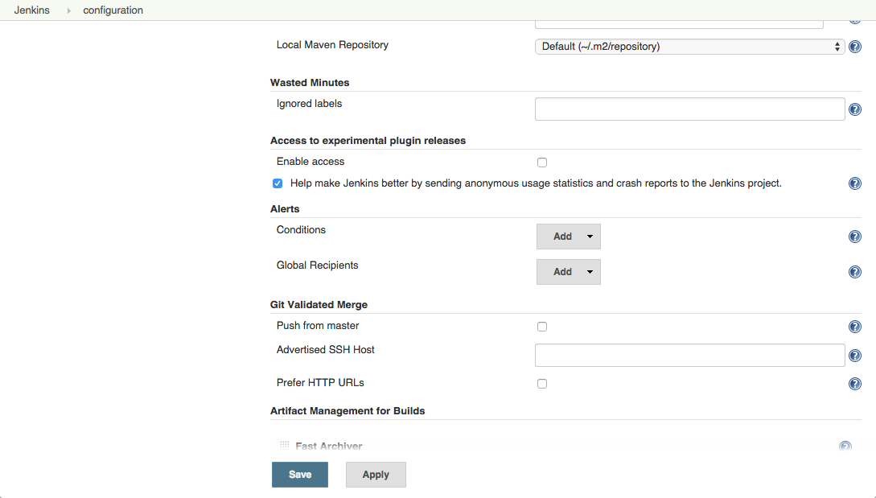
Where do we start?
In $JENKINS_URL/configure, scroll to Alerts section

Slide 116
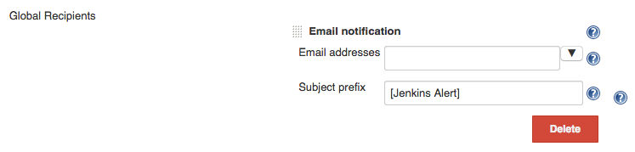
Where do we start?
Setup the Global Recipients with the email addresses to send the notifications to

Slide 117
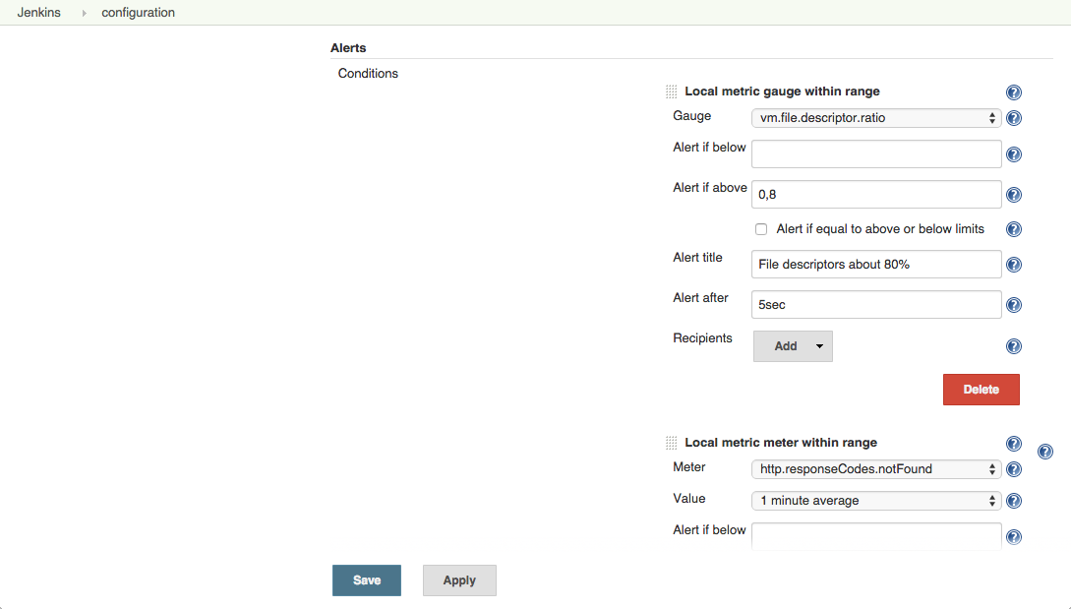
Where do we start?
Create the conditions

Slide 118
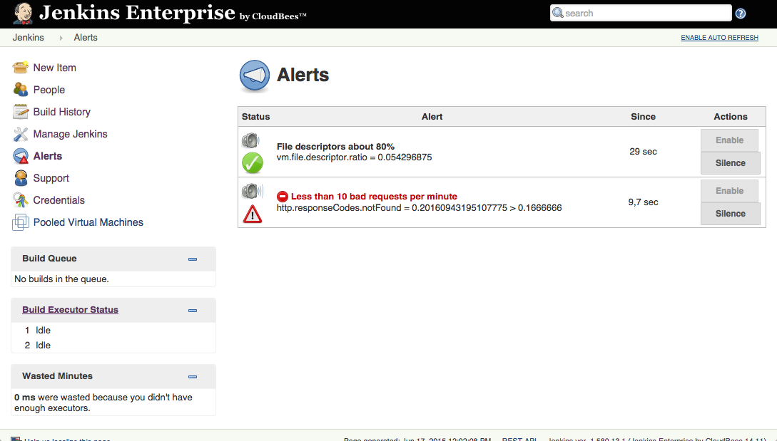
Where do we start?
Go to $JENKINS_URL/monitoring-alerts to observe the statuses

Slide 119
Lab Exercise:
Monitoring your Jenkins

Slide 120
Nodes Plus

Slide 121
What is Nodes Plus
Nodes Plus, available through Cloudbees Jenkins Enterprise package, is a plugin designed to allow nodes to have owners.
These owners can be notified when a nodes availability changes via email.

Slide 122
Benefits: Quickly alert node owners of node availability
Node owners can be alerted via email on a number of triggers.
Connected, disconnected, node failure and when the node temporarily goes offline.
Allows for quick turnaround of build nodes if a failure or disconnect occurs.

Slide 123
Where do we start?
Use the Nodes Plus configuration page to add owners and set criteria for notifications - Which build nodes require constant monitoring?
Set the criteria to cater to that nodes needs - Is an email required when a node fails? Maybe notification is only required on a disconnect?

Slide 124
Lab Exercise:
<labName>

Slide 126
Fast Archiver Plugin

Slide 127
What is Fast Archive
The Fast Archiver plugin uses an rsync-inspired algorithm to transfer archives from slaves to a master. The result is that builds complete faster and network bandwidth usage is reduced.

Slide 128
Benefits: Fast Archive
The Fast Archiver plugin takes advantage of the fact that there are usually only incremental changes between build artifacts of consecutive builds
Saving network bandwidth

Slide 129
Where do we start?
The Fast Archiver plugin is automatically installed and enabled if you have downloaded CloudBees Jenkins Enterprise. This plugin takes over the built-in artifact archiving functionality in Jenkins. If you are already using that feature, no configuration change is needed to take advantages of this feature.

Slide 130
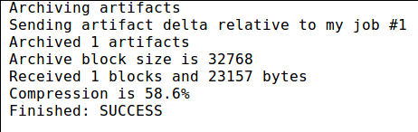
Where do we start?(Cont.)
Note
Note that fast archiving only occurs on builds run on a slave, not those run on the Jenkins master. Also there must have been previous builds which produced artifacts for the new artifacts to be compared to. Otherwise, Jenkins will perform a regular complete artifact transfer. It will do the same if the fast archiver detects that data is corrupted due to an internal bug.

Slide 131
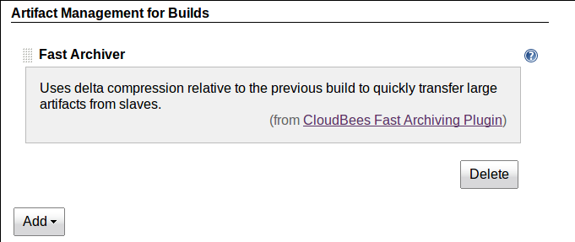
Where do we start?(Cont.)
Normally you need do nothing to configure fast archiving. As can be seen in Figure 8.2, “Fast archiving configuration”, this “artifact manager” is enabled by default when the plugin is first loaded. However you can remove this strategy and later read it in the main Jenkins configuration screen

Slide 132
Lab Exercise:
Fast Archive

Slide 134
Setting up Pull-Request Builder for GitHub

Slide 135
What is pull request
Automatic build will be initiated from jenkin and the result will be published on the repository when reviewer do pull request in Github/stash/bitbucket.
Any update to the pull request (new commit pushed, or amendment to existing commits in pull-request) will trigger another build and update the commit status

Slide 136
Benefits:<benefit>
We can make sure the new code merge from feature/branch to master doesn’t brake the build.

Slide 137
Where do we start?
The Pull Request Tester plugin is available within CloudBees Jenkins Enterprise update center. CloudBees Git Validated merge plugin is required, as Jenkins Github plugin.
The Pull Request Tester plugin is available within CloudBees Jenkins Enterprise update center. CloudBees Git Validated merge plugin is required, as Jenkins Github plugin

Slide 138
Where do we start?(cont.)
For full setup automation, credentials have to be configured in Jenkins global settings. Github API authentication require to create an access token. We recommend you create a dedicated pseudo-user on github to handle API interaction from Jenkins in Github, and have no interaction with actual developers profiles.

Slide 139
Where do we start?(cont.)
Go to your GitHub profile page.
In the left sidebar, click Applications.
Click Generate new token.
Give your token a descriptive name
Select the scopes to grant to this token. Pull request tester plugin require permission to administer repository hooks and access repositories: repo, public_repo, admin:repo_hook, repo:status.
Click Generate token.
Copy the token to your clipboard. For security reasons, after you navigate off this page, no one will be able to see the token again

Slide 140
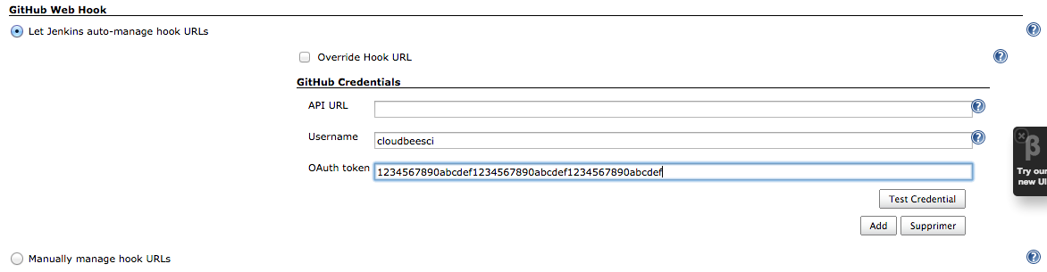
Where do we start?(cont.)
Configure your access token in Jenkins and validate Github API access.

Slide 141
Where do we start?(cont.)
Plugin introduce a new trigger option to Jenkins jobs, "Build pull requests to the repository". This option only makes sense if the job is building a project using a Github repository as SCM. Selecting this option will automatically register a web hook on Github so Jenkins get notified when pull-requests are created/updated.

Slide 142
Where do we start?(cont.)
Pull Request tester plugin relies on git validated merge, so this option has to be enabled as well, even if you don’t use this feature by yourself.
As a pull-request is opened on GitHub repository, Jenkins will trigger a build and report result in GitHub UI as "commit status" (a note associated to the latest commit of the pull-request). Any update to the pull request (new commit pushed, or amendment to existing commits in pull-request) will trigger another build and update the commit status

Slide 143
Lab Exercise:
Setting up Pull-Request Builder for GitHub

Slide 144
Custom Update Centers

Slide 145
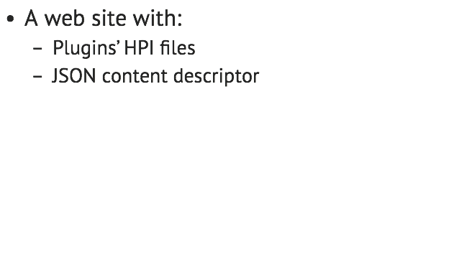
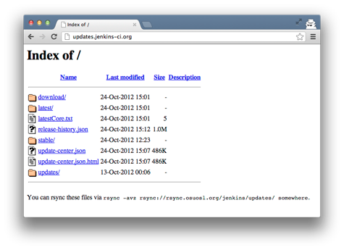
What is a Jenkins Update Center?

Slide 146
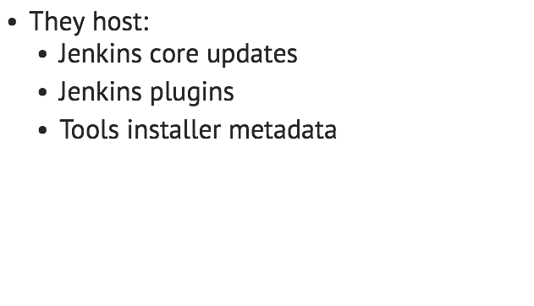
What is a Jenkins Update Center?

Slide 147
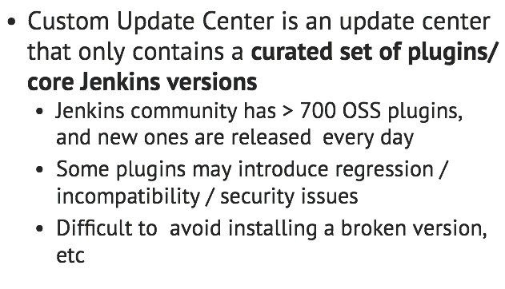
What is a Custom Update Center?

Slide 148
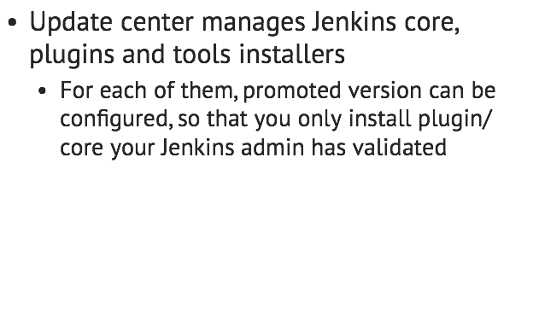
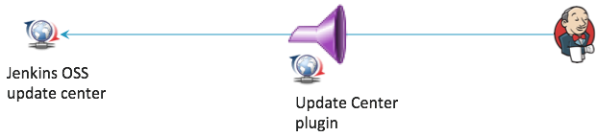
What is a Custom Update Center?

Slide 149
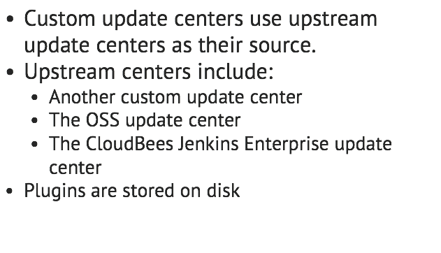
What is a Custom Update Center?

Slide 150
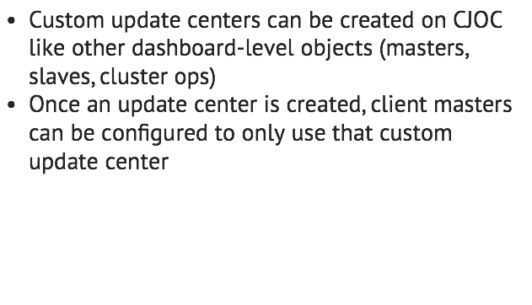
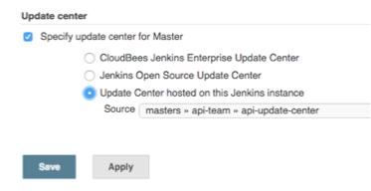
How do I use a Custom Update Center with CJOC?

Slide 151
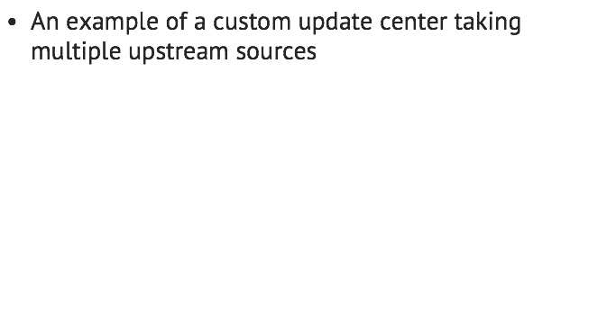
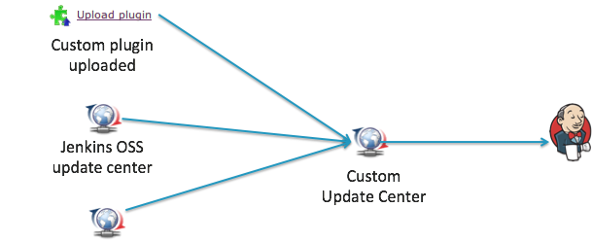

How do I use a Custom Update Center with CJOC?

Slide 152
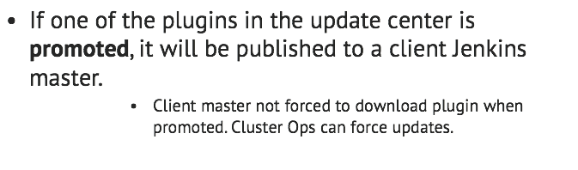
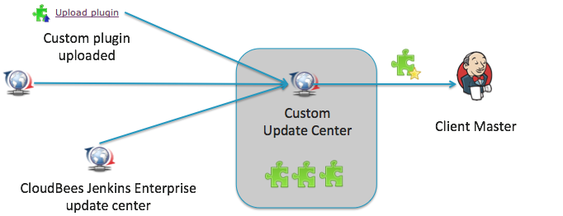
How do I use a Custom Update Center with CJOC?

Slide 153
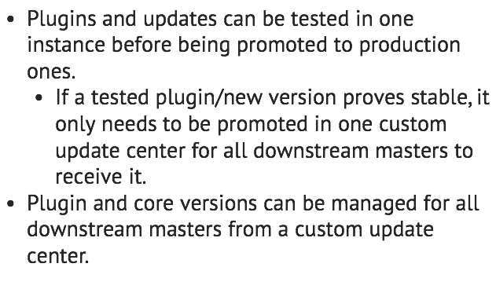
Benefits: manageability

Slide 154
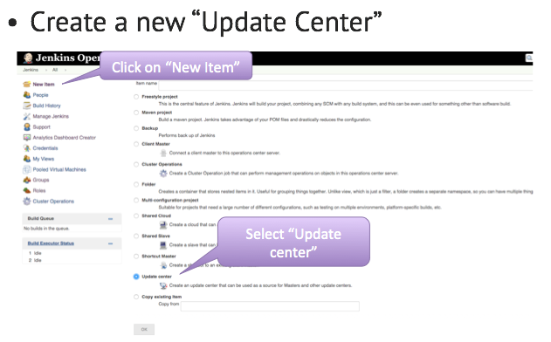
Where do we start?

Slide 155
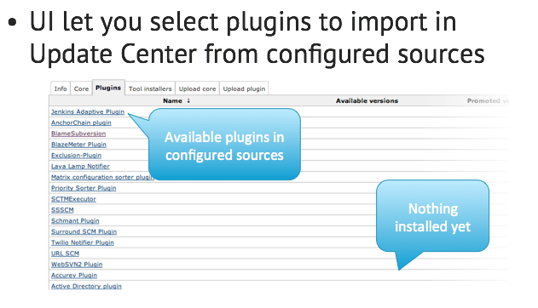
Where do we start?

Slide 156
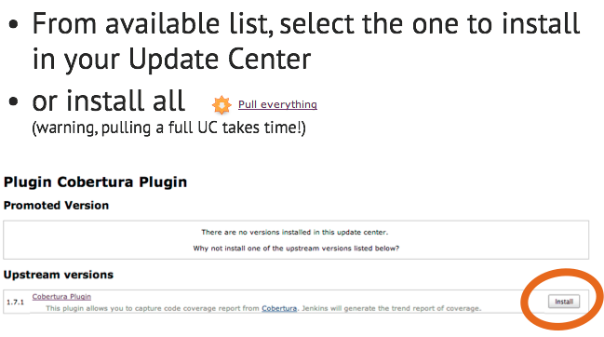
Where do we start?

Slide 157
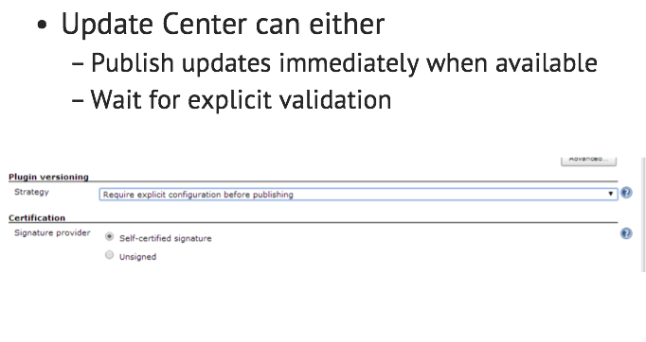
Where do we start?

Slide 158

Where do we start?

Slide 159
Lab Exercise:
Setting up a custom update center
[Admin] Custom Update Center Plugin.pptx

Slide 161
NIO SSH Slaves

Slide 162
What is NIO SSH Slaves
The NIO SSH Slaves plugin is an alternative SSH slave connector that uses a Non-Blocking I/O architecture. This alternative connector shows different scalability properties from the standard SSH slave connector

Slide 163
Benefits: NIO SSH Slaves
There are three main differences in scalability characteristics:
The Non-blocking I/O connector limits the number of threads that are used to maintain the SSH channel. Thus when there are a large number of channels (i.e. many SSH slaves) the Non-blocking connector will use less threads and consequently the Jenkins UI will remain more responsive than with the standard SSH slave connector.

Slide 164
Benefits: NIO SSH Slaves(Cont.)
When the Non-blocking I/O connector requires more CPU resources than are available, it responds by applying back-pressure to the channels generating the load. This allows the system to remain responsive at a consequence of increasing build times. It is important to note that under this type of load the traditional SSH slave connector typically has lost the connection with a corresponding build failure.

Slide 165
Benefits: NIO SSH Slaves(Cont.)
The Non-blocking I/O connector is optimized for reduced connection time. For example, it avoids copying the slave JAR file unless necessary; and by default it suppresses the logging of the slave environment.

Slide 166
What is NIO SSH Slaves(Cont.)
Another important technical note is that the SSH client library used in the Non-Blocking I/O connector currently only supports RSA and DSA key types and the maximum key size is determined by the JCE policy of the Jenkins Master’s JVM. Without installation of the unrestricted policy, the RSA key size will be limited to 2048 bits. Finally the Non-Blocking I/O connector currently does not support connecting to CYGWIN or other Microsoft Windows based SSH servers

Slide 167
Where do we start?
The plugin adds an additional launch method: Launch slave agents on Unix machines via SSH (Non-blocking I/O) The configuration options are almost identical to those in the traditional SSH Slaves connector.

Slide 168

Where do we start?

Slide 169
Where do we start?
The differences between the two plugins configuration parameters are as follows:
If specified, the Prefix Start Slave Command will be appended with a space character before being prepended to the start slave command. The traditional SSH Slaves connector requires that the user remember to end the prefix with a space or a semicolon in order to avoid breaking the slave launch command.

Slide 170
Where do we start?
If specified, the Suffix Start Slave Command will be prepended with a space character before being appended to the start slave command. The traditional SSH Slaves connector requires that the user remember to start the suffix with a space or a semicolon in order to avoid breaking the slave launch command.

Slide 171
Where do we start?
The traditional SSH Slaves connector will always copy the slave environment variables to the slave launch log. The NIO SSH Slaves connector provides this as an option that defaults off. The logging of the slave environment is only of use when debugging initial connection issues and has a performance impact on the startup time. Once the slave channel has been established the slave environment variables are accessible via the Node’s System Information screen

Slide 172
Lab Exercise:
NIO SSH Slaves

Slide 173
Even Scheduler Plugin

Slide 174
What is the Even Scheduler plugin?
When using many slave nodes, Jenkins needs to decide where to run any given build.
This is called scheduling.

Slide 175
What is the Even Scheduler plugin?
Node selection is done in 2 steps:
1) Filter nodes where the build can be executed.
a Windows slave required to build a windows installer
a MacOS slave required to build an iOS application
...
2) One node amongst all the qualifying nodes in (1) must be selected to carry out the build
While (1) is processed by Jenkins core, (2) can be customized by a plugin: this is what the even scheduler plugin does

Slide 176
What is the consistent hashing algorithm?
Default Jenkins Behavior
From the user’s point of view:
Jenkins tries to always use the same node for the same job
If not available, it’ll build elsewhere
but comes back to preferred one as soon as it is available

Slide 177
What is the consistent hashing algorithm?
From the technical point of view
Jenkins creates a priority list for each job that lists all the slaves in their preferred order, then picks the most preferred available node.
Technically: hashes the name of the node (in numbers proportional to the number of available executors) and the job name to create a probe point for the consistent hash.
This priority list is
different from one job to another
stable, in that adding or removing nodes generally only causes limited changes to these priority lists.

Slide 178
What is the consistent hashing algorithm?
Based on the assumption that it is preferable to use the same workspace as much as possible
because SCM updates are more efficient than SCM checkouts.
with many jobs, this tends to keep the number of the workspaces on each node small.
some build tools (such as Maven and RVM) use local caches, and they work faster if Jenkins keeps building a job on the same node
...

Slide 179
What is the consistent hashing algorithm?
Downside of this strategy:
Jenkins doesn’t try to actively create balanced load on nodes
Example:
Build FOO #1 running on Slave X
3/7 chance BAR #1 still gets assigned to X
Build queue
Build BAR #1
Slave X
Slave Y
Executor #1
Executor #1
Build FOO #1
Executor #2
Executor #2
?
Executor #3
Executor #3
3/7 chance to be assigned on SlaveX
Executor #4
Executor #4
Notes:
Say you have two slaves X and Y, each with 4 executors. If at one point X is building FOO #1 and Y is completely idle, then on average, the upcoming BAR #1 still gets assigned to X with 3/7 chance (because X has 3 idle executors and Y has 4 idle executors.)

Slide 180
What is the even loading algorithm?
The even scheduler plugin offers a different scheduling algorithm, known as even loading strategy
Under this strategy, the scheduler prefers idle nodes absolutely over nodes that are doing something
With this algorithm, the total capacity of the system does not change—only the order in which the available capacity is filled.

Slide 181
What is the even loading algorithm?
Back to our example:
BAR #1 will always run on Y, because X is currently building FOO #1
Even though it still has 3 idle executors, it will not be considered so long as there are other qualifying slaves that are completely idle.
Build queue
Build BAR #1
Slave X
Slave Y
Executor #1
Executor #1
Build FOO #1
Executor #2
Executor #2
?
Executor #3
Executor #3
Idle SlaveY will be privileged
Executor #4
Executor #4

Slide 182
Benefits: efficiency
Even loading is most useful for jobs which are slow to build, but for which the very first build on a node is not notably slower than any other.
You are more likely to get a fully idle node
Executing a build on a fully idle system is faster than executing the same thing on a partially loaded system, all else being equal.
But if the node does not have a workspace already initialized for this job, you’ll pay the price of fully checking out a new copy, which can cancel other performance gains.

Slide 183
Where do we start?
Global preference
Picks the scheduling algorithm globally for all jobs, unless specifically overridden by individual jobs.
How to activate it?
Go to Manage Jenkins
Select System Configuration
Select for Default Scheduler Preference the entry Prefer execution on idle nodes over previous used nodes

Slide 184
Where do we start?
Per-job preference
Picks the scheduling algorithm for a specific job, regardless of the global preference.
How to activate it?
Go to the configuration screen of a job
Select Override the default scheduler preference
Select Prefer execution on idle nodes over previous used nodes

Slide 185
Lab Exercise:
Even Scheduler Plugin

Slide 186
CloudBees Jenkins Analytics

Slide 187

What is CloudBees Jenkins Analytics?

Slide 188


What is CloudBees Jenkins Analytics?

Slide 189

Benefits: installation insights

Slide 190


Where do we start?

Slide 191
Lab Exercise:
<labName>

Slide 192
Cluster Operations

Slide 193

What is Cluster Operations?

Slide 194

What is Cluster Operations?

Slide 195

What is Cluster Operations?

Slide 196

What is Cluster Operations?

Slide 197


What is Cluster Operations?

Slide 198


What is Cluster Operations?

Slide 199

Benefits: maintainability

Slide 200

Where do we start?

Slide 201
Lab Exercise:
Setting up a plugin update Cluster Operation

Slide 203
CloudBees Support

Slide 204
What is CloudBees Support
The Support plugin provides the ability to generate a bundle of all the commonly requested information used by CloudBees when resolving support issues

Slide 205
Benefits: CloudBees Support
Since some CloudBees customers purchase support contracts without being licensed for CloudBees Jenkins Enterprise, this plugin is also available for download and installation into any Jenkins installation. Simply go to the plugin’s release notes, pick the latest version, and click the link in the Download section (such as to http://jenkins-updates.cloudbees.com/download/plugins/cloudbees-support/*latest*/cloudbees-support.hpi). You can install the downloaded plugin using Manage Jenkins » Manage Plugins » Advanced » Upload Plugin

Slide 206
Where do we start?
To generate a bundle, simply go to the CloudBees Support link on the Jenkins instance.

Slide 207

Where do we start?(Cont.)

Slide 208
Lab Exercise:
CloudBees Support

